Slide 1

ELLIPTICALLY FOCUSSED CONVERGENCE
FOR DUAL-MODE TUMOUR ABLATION AND MITOTIC DISRUPTION
DOUSIK MANOKARAN
PSG INSTITUTE OF TECHNOLOGY AND APPLIED RESEARCH
23l130@psgitech.ac.in
Antenna Design Contest Using Altair® Feko®

Slide 2
01
About The Project
Key Insights Behind the Design
My project represents a culmination of inspirations drawn from advanced medical techniques and fundamental mathematical concepts.
RF Ablation Principle
Microwave Heating
Radiofrequency ablation provides deeper tissue penetration without surgical invasion, making it ideal for targeting tumors in complex organ systems.
Recognized as one of the most effective tumor treatment methods, microwave ablation offers localized heating to destroy tumor tissues minimally invasively.
Mitotic Disruption via Polarization
Research shows that tumor growth can be arrested by exposing cancer cells to electromagnetic waves with precise polarization alignment, disrupting the mitotic spindle formation during cell division.

Slide 3
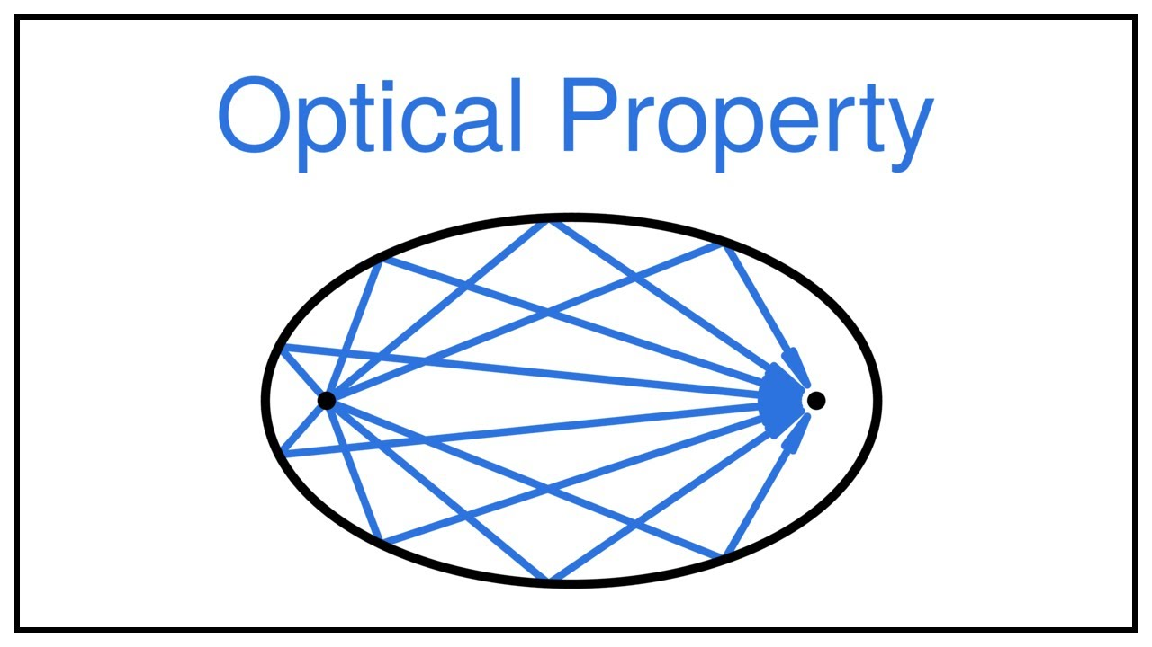
02
About The Project
What Makes Our Design Unique
By integrating these three distinct concepts—mitotic disruption, microwave ablation, and RF-based deep penetration—and applying a fundamental mathematical principle of ellipsoids, I have developed an innovative antenna-reflector system:
The elliptical reflector exploits the unique geometrical property of ellipsoids, where all waves originating from one focal point naturally converge at the second focal point—the tumor site—with maximum intensity and minimal energy loss.
The use of circularly polarized microwaves ensures continuous mitotic disruption, as the rotating electric field interacts with tumor cells at every orientation, enhancing treatment effectiveness.
Leveraging a half-elliptical design, the system utilizes back and side radiation efficiently.
Each locus of the ellipse forms a distinct, non-intersecting EM path, allowing electromagnetic waves to travel independently. This unique property ensures minimal interference between adjacent waves after reflection, except at the focal point, where energy convergence is maximized for targeted tumor ablation.

Slide 4
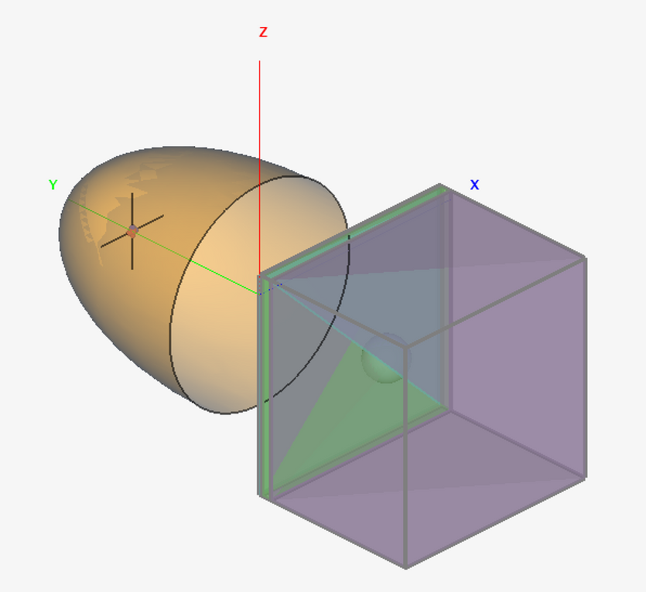
The Model
View
Isometric View

Slide 5
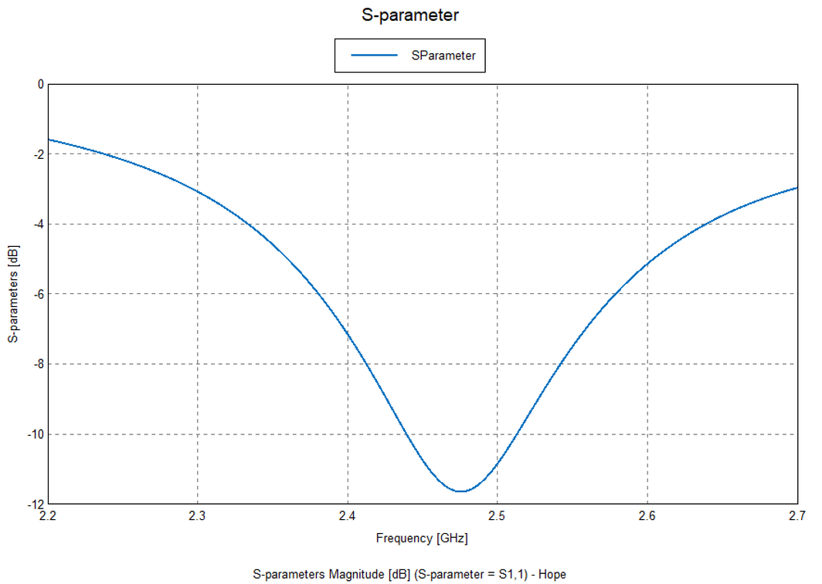
03
a. Operating Frequency
2.4 GHz - 2.5 GHz
The antenna has been successfully configured to operate within the 2.4–2.5 GHz ISM (Industrial, Scientific, and Medical) band, ensuring broader compatibility with medical applications and adherence to regulatory standards. This frequency range offers an optimal balance between penetration depth and localized heating, making it ideal for microwave ablation and polarization-based mitotic disruption in tumor treatment.
Parameters

Slide 6
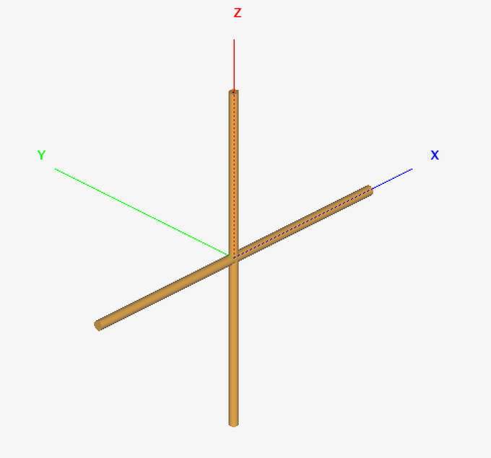
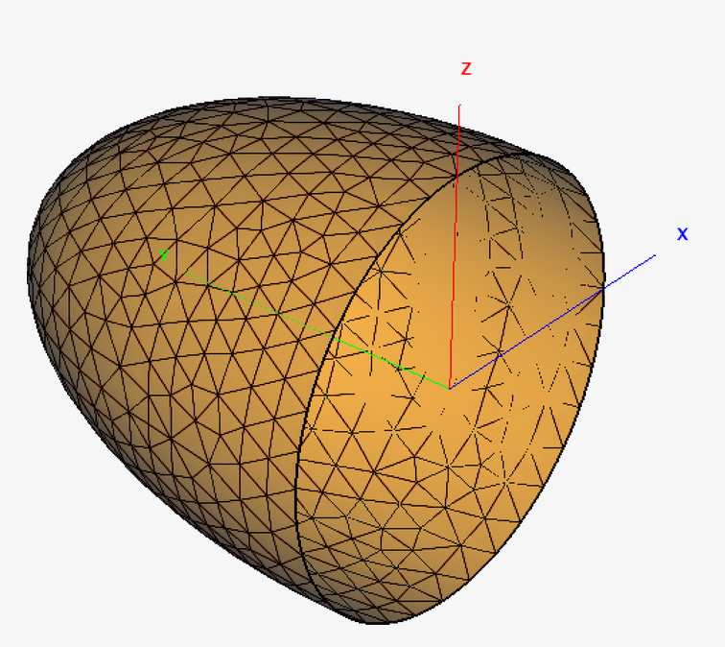
04
Parameters
b. Type of Antenna
Double Dipole Antenna with 90° phase shift difference (PEC)
Elliptical Reflector (PEC)
• Dimensions: 35.06 x 35.06
• Dimensions: 100 x 50 x 50
Unit: mm

Slide 7
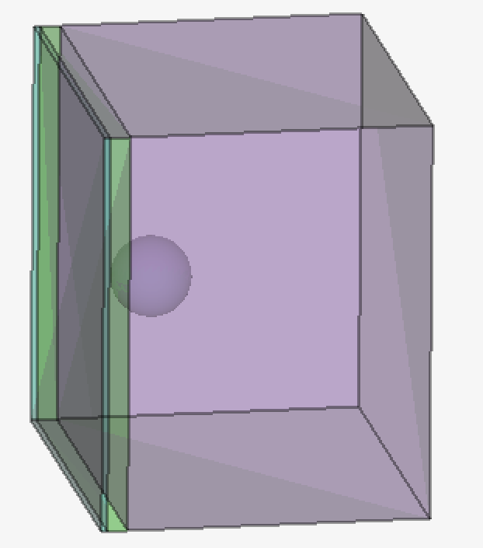
04
c. Tissue Phantom Model
An approximate multilayered tissue phantom model was developed, consisting of four distinct layers: skin, fat, muscle, and a spherical tumor embedded within. The tumor’s position was precisely aligned with the second focal point of the elliptical reflector, ensuring maximum energy convergence.
Each tissue layer was assigned individual dielectric constants, conductivity values, and loss tangents, derived from standard research literature, tailored specifically for the operating frequency band under consideration.
Parameters

Slide 8
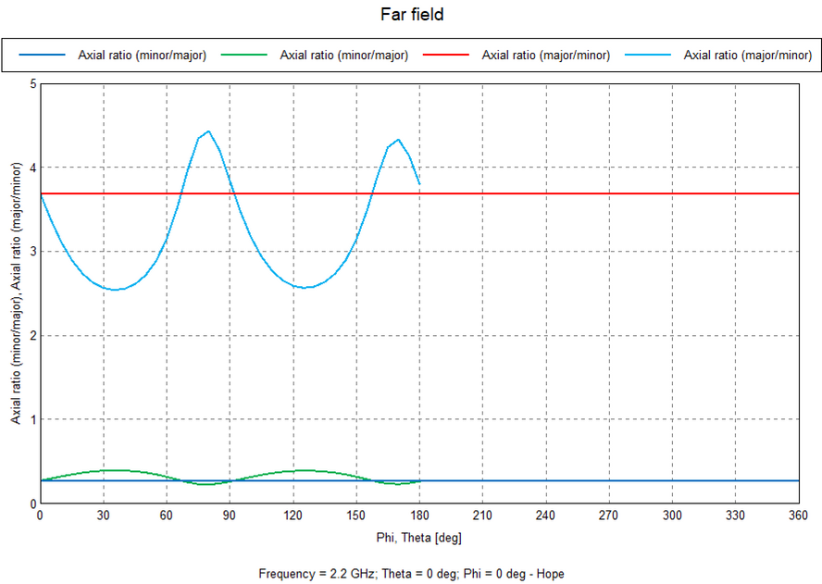
05
d. Type of Polarization
To leverage the advantages of mitotic disruption through polarization, an antenna capable of generating circular polarization was modeled. However, circular polarization alone is insufficient, as it primarily addresses polarization in two dimensions. For effective tumor disruption, three-dimensional irradiation is essential.
This challenge is also resolved by an elliptical reflector, which exploits the unique geometrical properties of ellipsoids.
Parameters
Note: Each axial plot is in a different scale. Thus, it is better to view them individually in the model.

Slide 9

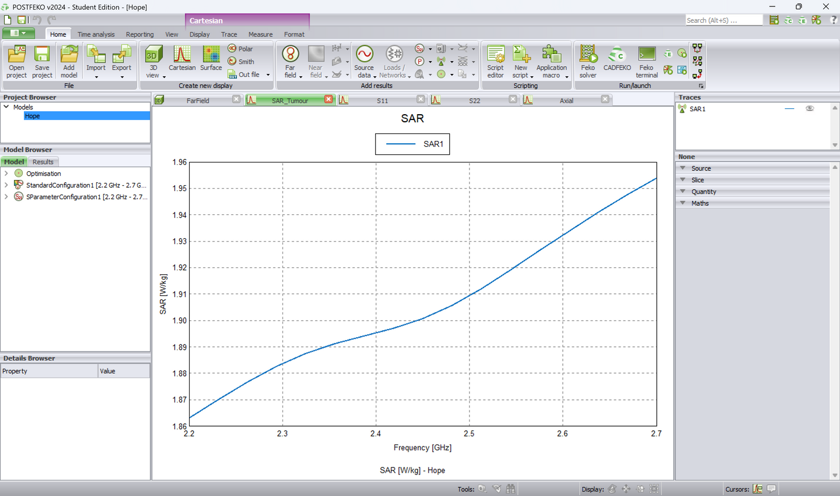
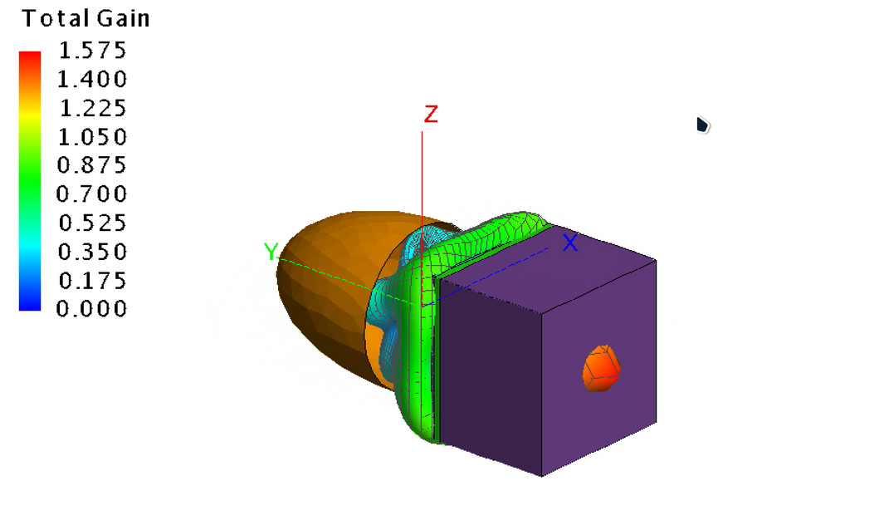
06
Results
S11
SAR
Far Field

Slide 10
THANK YOU!
DOUSIK MANOKARAN
PSG INSTITUTE OF TECHNOLOGY AND APPLIED RESEARCH
23l130@psgitech.ac.in
Antenna Design Contest Using Altair® Feko®

